Slide 1
Master Thesis
Images for Thesis and presentation

Slide 2



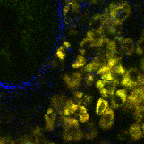
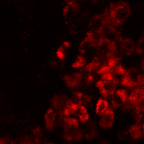

Napari
Point cloud
Labeling with points in 3D
Training data
Density maps for multiple cell classes
U-net
Stack
NADH
Cell Number
Threshold + Object counting

Slide 3


Stack
Simulator
Data
Napari
FIJI
or
Annotation
PointCloud.csv
PointCloud.roi
PointCloud
NADH
PointCloud
NADH Synthetic
Training data
U-net
U-net

Slide 4
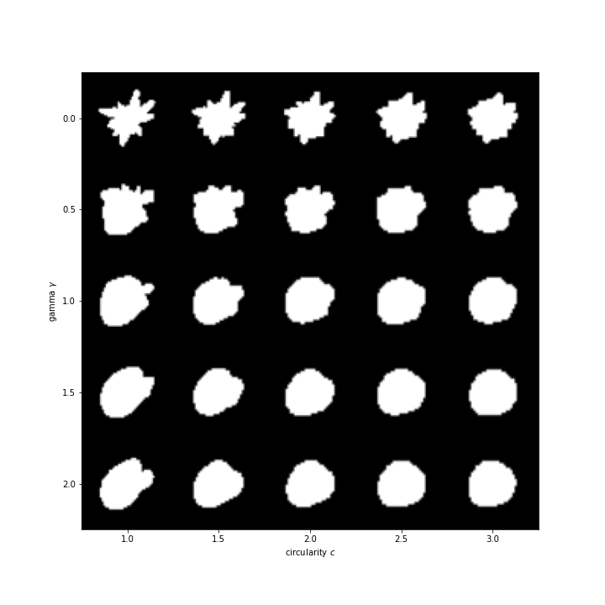
Shape generation with differrent parameters

